Slide 1
Social White hat Hackers
Problem Statement: Enabling Common and mentally disabled people to make better decisions and easier payments Specific to Retail Store Experience
Saurav Kumar Soumyajit Kolay Sambuddha Chatterjee SUDIP CHANDA Karthik Dhulipati

Slide 2
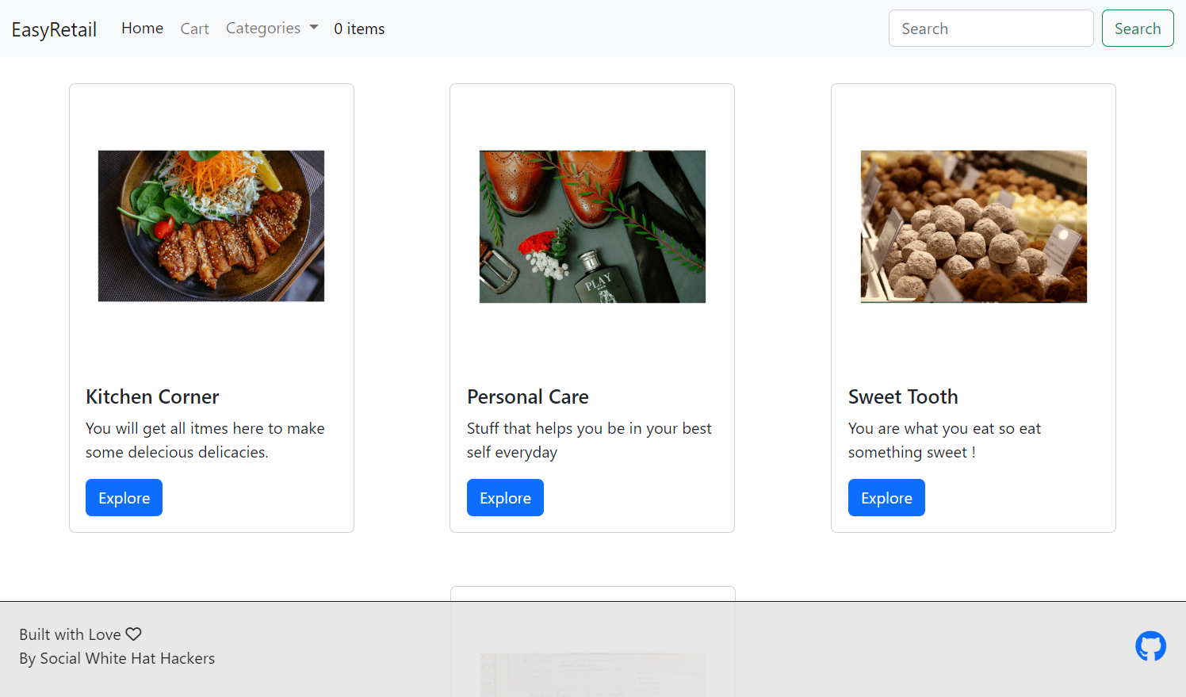

Slide 3
Navbar – to aid the navigation across the website

Slide 4
Item Categories – Helps choose the type of product

Slide 5
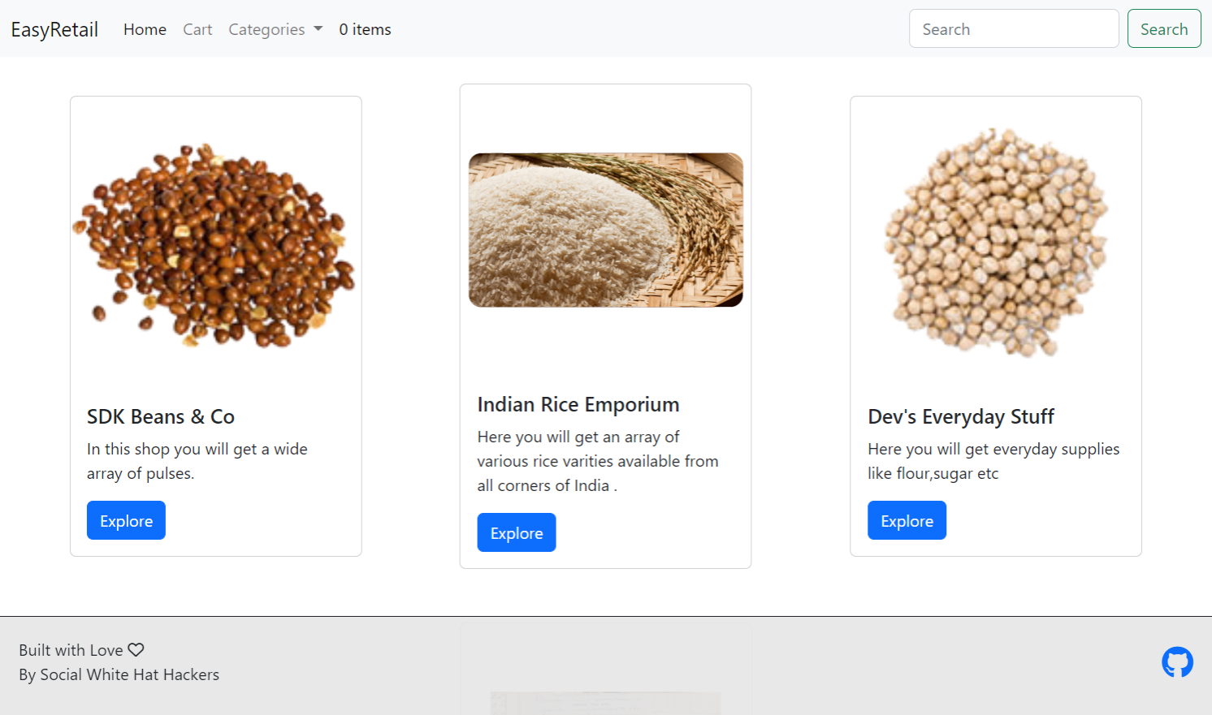
Helps Navigate to Different Stores

Slide 6
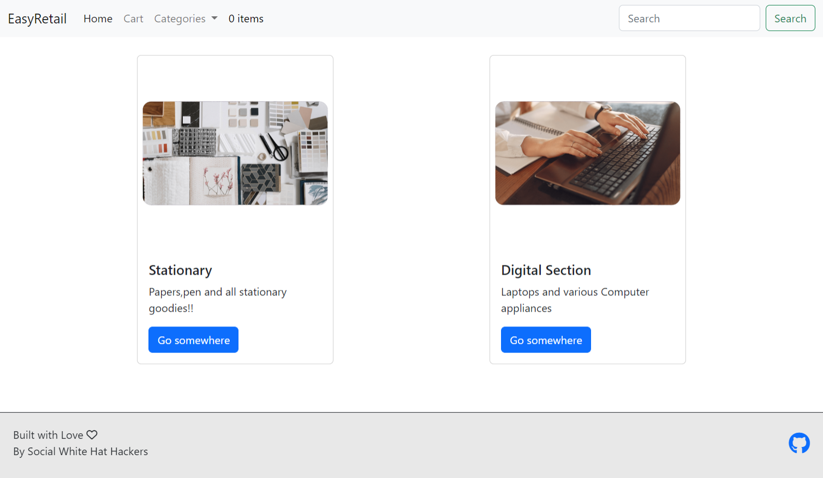
Example of Different Sections of Store

Slide 7
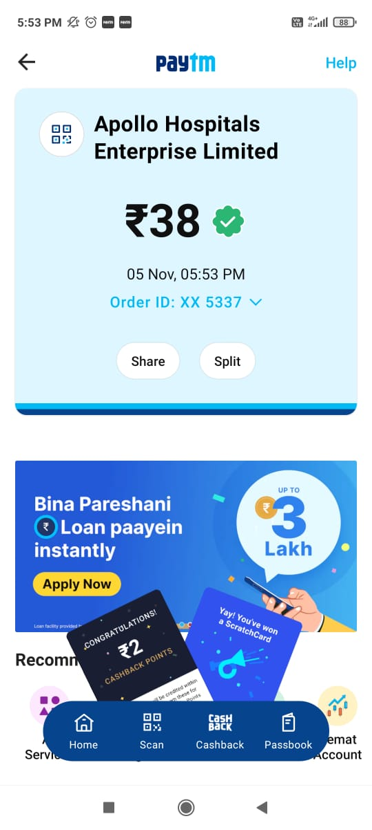


Indian Rice Emporium
After Selection of Items, The Program shall ask the family members/guardians of the disabled person for Approval of the Transaction along with the list of Items Selected.
 Ask for Assistance
WAITING FOR APPROVAL Waiting for your family members to approve Transaction…
9 Items

Slide 8

Indian Rice Emporium
After approval of the family members, the transaction can proceed forward.
 Ask for Assistance
TRANSACTION APPROVED! Your family members approved the Transaction!
9 Items Purchased

